Slide 1

NYPD Shooting Incident Data Report

Slide 2

Introduction
The determination of the sectional evaluation of NYPD shooting incidents derives from the involvement of the analytical approach.
This executes the context of the determining evaluation where the analytical parts are introduced.
The collection of the data introduces the implementation of NYPD websites.
Notes:
This determines the involvement of the New York City shooting incidents. The evaluation also derives the value of the incidences or cases from the year 2006. The determining approaches provide the finding of the incident data values with the assistance of R-programming.

Slide 3

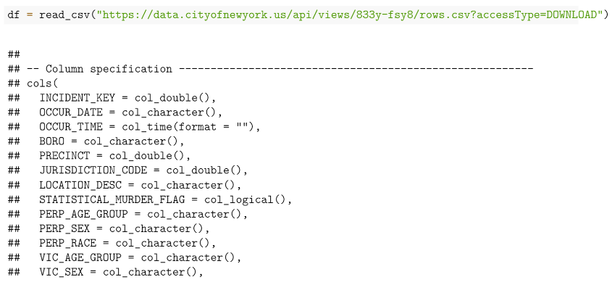
Finding & Analysis
The first section of determination introduces the implementation of the necessary libraries such as ‘tidyverse’, and ‘lubridate’.
Each library is implemented to make a test bench environment for the determination of the overall execution approach (Rampin, and Rampin, 2021).
After the initialization of the libraries, the CSV data read section is introduced to read the CSV data values.
Notes:
This introduces the implementation of the assigning of the data values to a particular data variable. The concept of data frame construction is implemented in this proportion. In this section date value conversion is implemented to convert the data as per the requirement.

Slide 4
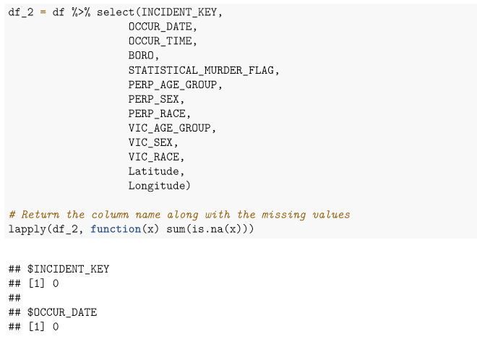
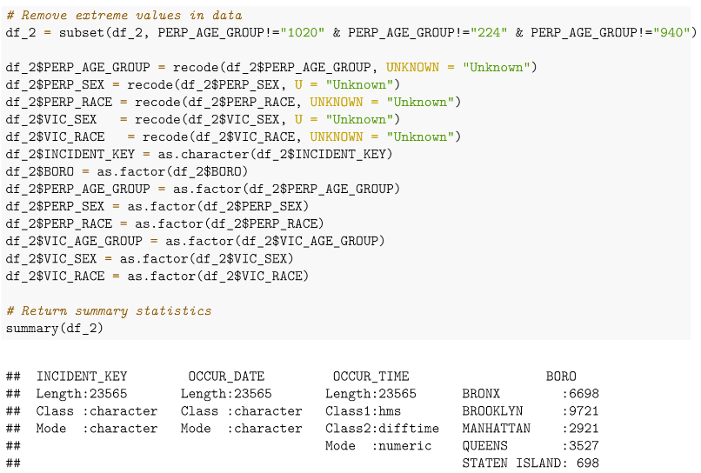
Contd…
The next section determines the finding of the missing or blank section of the data.
This determines the introduction of the cleaning mechanism (Matusiak et al., 2022).
In this mechanism, the data is converted into a suitable structure where no data values are found.
The constructional determination defines the removal of the unused part, and also the replacement of the blank with an ‘Unknown’ data string.
Notes:
The ‘head’, and ‘summary’ approaches are applicable to determine the main farmer, columns, and other parts of the data. The determining values also find the statistical deriving factors that introduce some statistical calculative outcomes of the system.

Slide 5
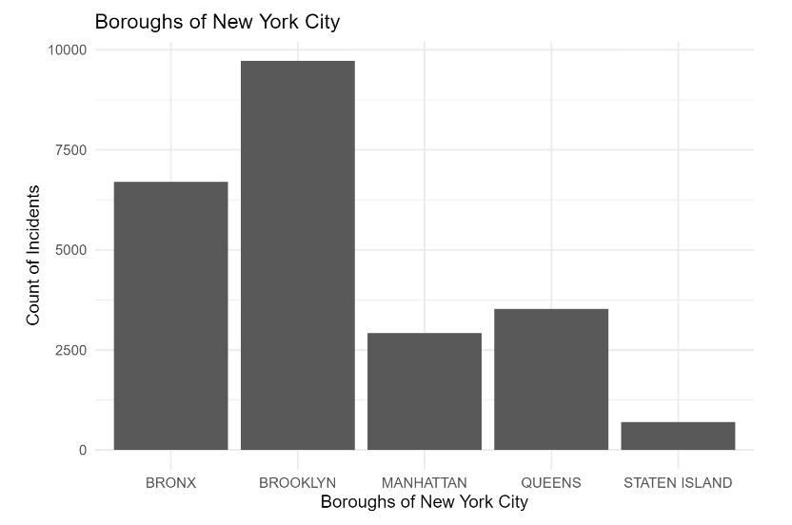
Contd…
The determination of the constructive data functionalities derives from the evaluation of the data using ‘Tidy’.
This introduces the final outcome of the data by using some necessary data evaluation, and analytical concepts (White, 2020).
The last section of the determination demonstrates the plotting of the data using some suitable chart (bar).
Notes:
This introduces the relational evaluation between the x and y variables. In this case, the relational determination is evaluated between ‘Boroughs of New York City’, and ‘Count of Incidents’. The chart introduces a suitable title, an x-label, and also the y-label. The determining values introduce the evaluation and the finding of the highest section of shooting incidents in New York. The last section of determination also introduces the evaluation of the table which contains the name of the cities, and the true as well as false incident case count values.

Slide 6
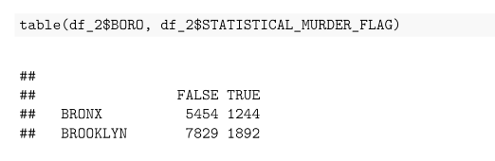
Conclusion
All-over evaluation introduces the incident of shooting in New York with the assistance of NYPD data.
This introduces the location-wise total number of cases.
The determination also introduces the evaluation outcome that supports the construction of the R-programming.
Notes:
The coding approach determines the initiation of libraries, data collected, reading concept, null value checking, removal, replacement, plotting of data, and so on. Each section of determination evaluates the main context of execution which supports the major key finding of the investigation.

Slide 7
References
Rampin, R. and Rampin, V., 2021. Taguette: open-source qualitative data analysis. Journal of Open Source Software, 6(68), p.3522.
Matusiak, M.C., Cavanaugh, M.R. and Stephenson, M., 2022. An assessment of officer-involved shooting data transparency in the United States. Journal of interpersonal violence, 37(1-2), pp.472-496.
White, M.D., 2020. The New York City Police Department, its crime control strategies and organizational changes, 1970-2009. In Understanding New York’s Crime Drop (pp. 74-95). Routledge.

Slide 8


